Slide 1
Lecture 25: CFG to PDA
Agenda:
CFG to PDA Conversion
Steps to convert CFG to PDA
Example
Presented by
Prof. Vaibhav Narayan Chunekar
K. J. Somaiya College of Engineering, Vidyavihar, Mumbai
KJSCE

Slide 2
PDAs Accept
Context-Free Languages
KJSCE

Slide 3

Theorem:
Context-Free
Languages
(Grammars)
Languages
Accepted by
PDAs
KJSCE

Slide 4
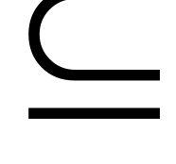



Proof - Step 1:
Context-Free
Languages
(Grammars)
Languages
Accepted by
PDAs
Convert any context-free grammar
to a PDA with:
KJSCE

Slide 5

Proof - Step 2:
Context-Free
Languages
(Grammars)
Languages
Accepted by
PDAs
Convert any PDA to a context-free
grammar with:
KJSCE

Slide 6
Convert
Context-Free Grammars to
PDAs by Final State
Proof - step 1
KJSCE

Slide 7


Take an arbitrary context-free grammar
We will convert to a PDA such that:
KJSCE

Slide 8
Conversion of CFG to PDA
Prerequisite:
Given CFG , a production rule of the form T→ aU where a is input symbol and T is previous Top of stack , U is new Top of the stack.
The symbol T is popped off and symbol U is pushed onto the stack.
If it is a terminal production of the form T→a then
The input symbol a is consumed and the stack is just popped.
Thus there is correspondence between production rules in a CFG and transition in a PDA.
If there are more than one Non Terminals are on RightHand Side e.g. T→ aUXYZ then sequence of pushing Z follow Y and so on.
KJSCE

Slide 9
General Method for Construction of CFG to PDA
1. Convert the given CFG to Greibach Normal Form(GNF)
2.From the start state q0 of the PDA
a)Add a transition to a new state q1 with the label
( λ, $;S$)
3. For each production rule of the form T→ aUXY$.....
a) Add a transition from q1 to q1 with the label
( a,T;UXY$.......)
4. From state q1, add a transition to a new final state q2 with the label ( λ, $;$)
KJSCE

Slide 10


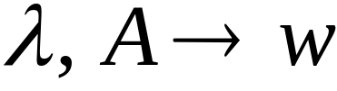
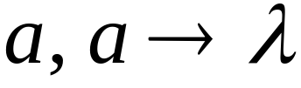
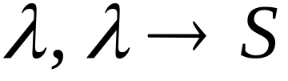




Conversion Procedure:
For each
For each
production in
terminal in
Add transitions
KJSCE

Slide 11
Example 1 Conversion of CFG to PDA
Convert a given CFG to PDA:
S→ aSa| bSb| λ
Step 1: Convert the Grammar into GNF
S→ aSA|bSB|λ
A→ a
B→ b
KJSCE

Slide 12
Step 2 :Conversion CFG to PDA
Add a transition to a new state q1 with the label
( λ, $;S$)
qo λ, $;S$ q1
KJSCE

Slide 13
Step 3 : For each production of the form T→ aUXY$
Add a transition to a state q1 to state q1 with the label
( a, T;UXY$)
a,S;SA
b,S;SB (Pushing Symbol Stack)
qo λ, $;S$ q1
KJSCE

Slide 14
Step 4 : Transition state from q1 to q2
Add a transition to a state q1 to state q2 to pop up the Stack element
a,S;SA bB→λ aA→λ ( Pop Up)
b,S;SB (Pushing Symbol Stack)
qo λ, $;S$ q1 q2
KJSCE

Slide 15
Step 4 : Final PDA
Add a transition to a state q1 to state q2 to pop up the Stack element
a,S;SA bB→λ aA→λ ( Pop Up)
b,S;SB (Pushing Symbol Stack)
qo λ, $;S$ q1 q2 λ,z,z q3
KJSCE

Slide 16
Step 4 : Final PDA
Add a transition to a state q1 to state q2 to pop up the Stack element
a,S;SA λ,S; λ bB→λ aA→λ ( Pop Up)
b,S;SB (Pushing Symbol Stack)
qo λ, $;S$ q1 λ,$,$ q2
KJSCE

Slide 17
Final PDA
Q= {q0,q1,q2}
Σ= {a,b}
Γ={S,A,B,$}
q0= { q0 }
Stack Start symbol = { $ }
Final State= {q3}
δ= ?
KJSCE

Slide 18
Final PDA
δ➔Instantaneous Description
(q0, λ ,$ ) q1,S$ -------1
(q1, a ,S ) q1,SA -------2
(q1, b ,S ) q1,SB -------3
(q1, λ ,S ) q1, λ -------4
(q1, a ,A ) q1, λ -------5
(q1, b ,B ) q1, λ -------6
(q1, λ ,$ ) q2,$ -------7
KJSCE

Slide 19
Illustration with String
abaaba ( for given CFG ie.Equal number of a’s or b’s)
q0 abaaba $
q1 abaaba S$
q1 baaba AS$
q1 aaba SABA$
q1 aba ABA $
q1 ba BA $
q1 a A $
q1 λ $
q2
KJSCE

Slide 20
Problem To be solved by you Homework
Palindrome: S→ aSa | bSb|C
S→a|aS|bSS|SSb|SbS
na(x)>nb(x)
WW^{R (Reverse String)}
KJSCE

Slide 21
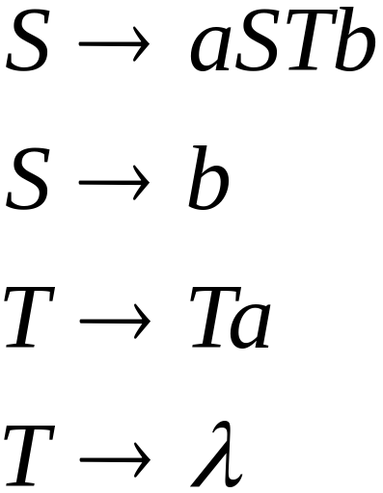
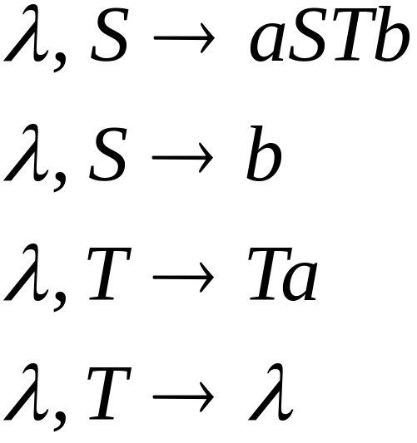
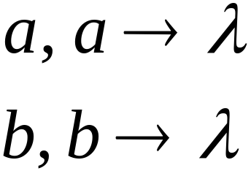
Example 2
Grammar
PDA
KJSCE

Slide 22
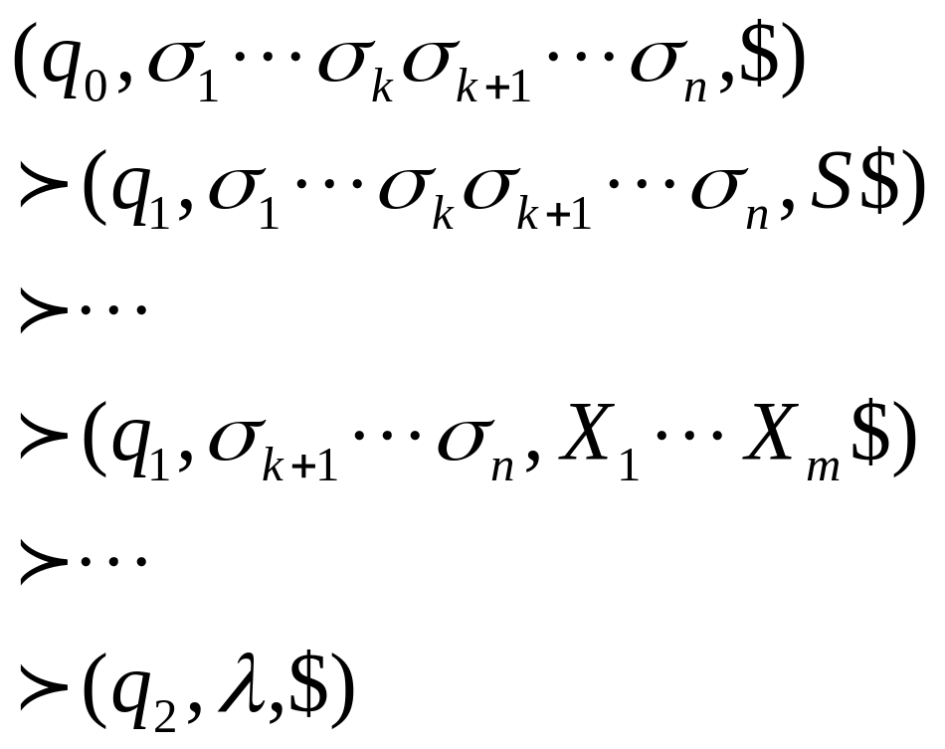
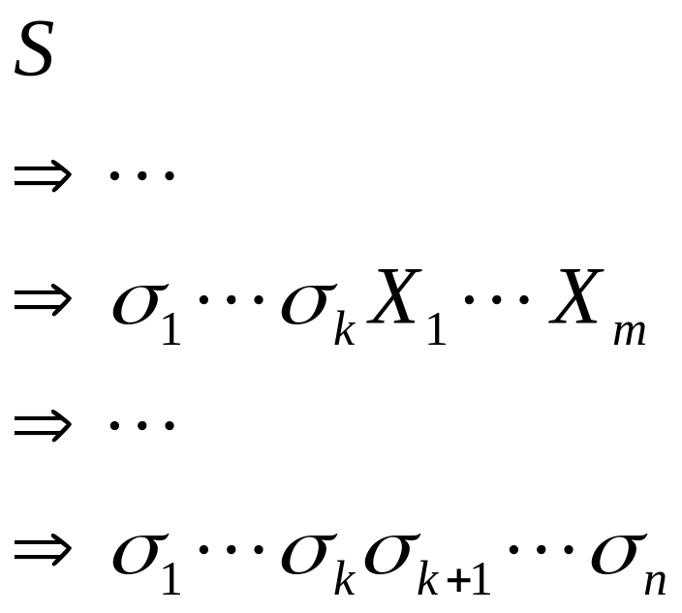
PDA simulates leftmost derivations
Grammar
Leftmost Derivation
PDA Computation
Scanned
symbols
Stack
contents
KJSCE

Slide 23
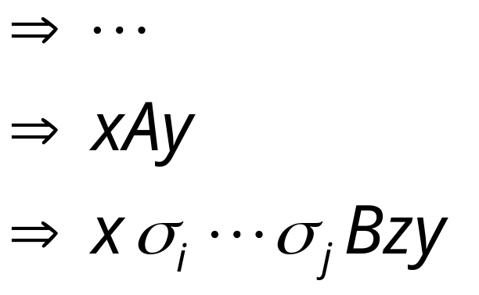
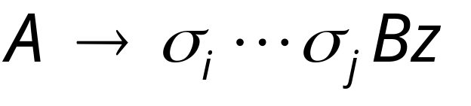
Grammar
Leftmost Derivation
Leftmost
variable
Variables
or terminals
Terminals
Production applied
Variables
or terminals
Terminals
Variable
KJSCE

Slide 24
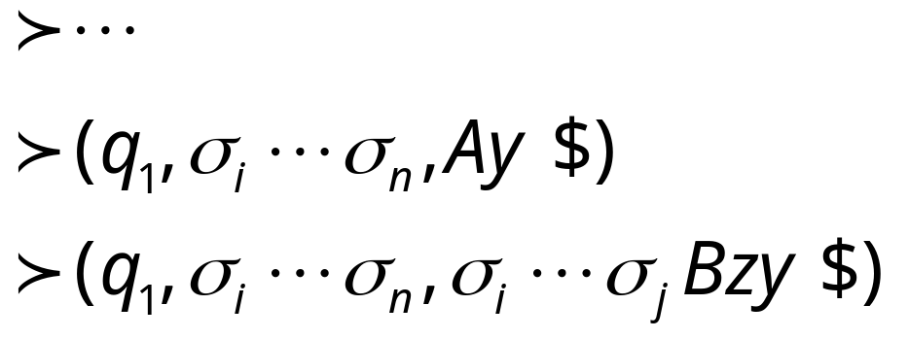
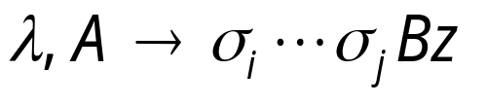
Grammar
Leftmost Derivation
PDA Computation
Production applied
Transition applied
KJSCE

Slide 25

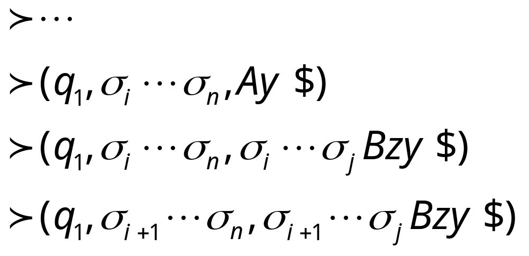
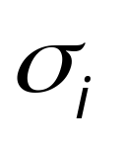

Grammar
Leftmost Derivation
PDA Computation
Transition applied
Read from input
and remove it from stack
KJSCE

Slide 26

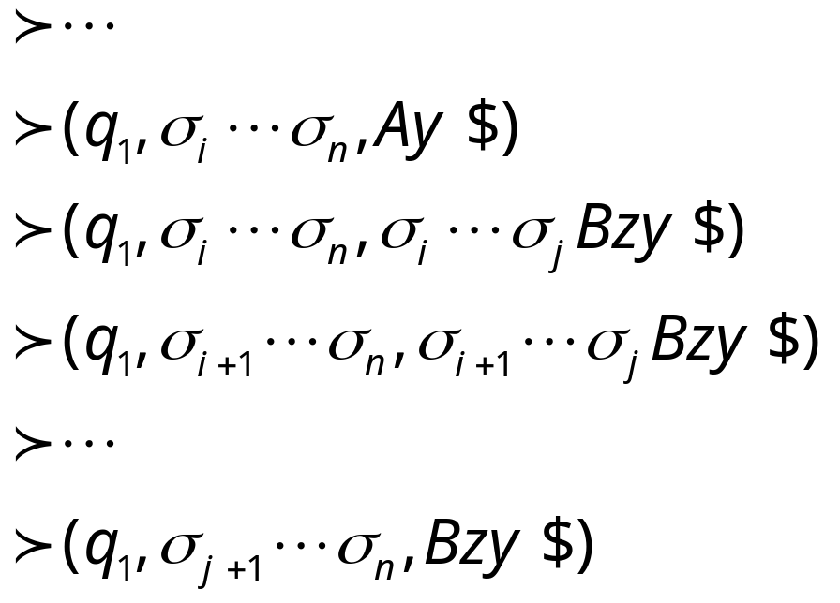
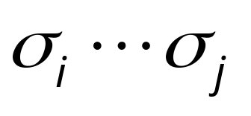
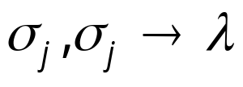
Grammar
Leftmost Derivation
PDA Computation
Last Transition applied
All symbols
have been removed from top of stack
KJSCE

Slide 27
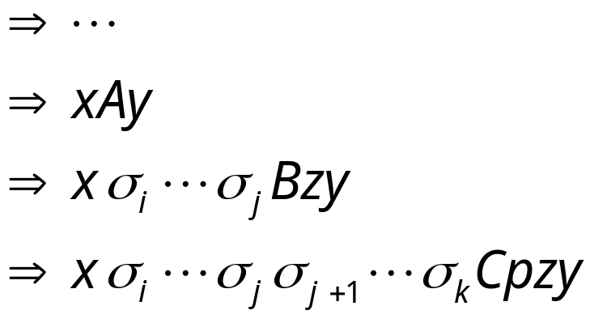
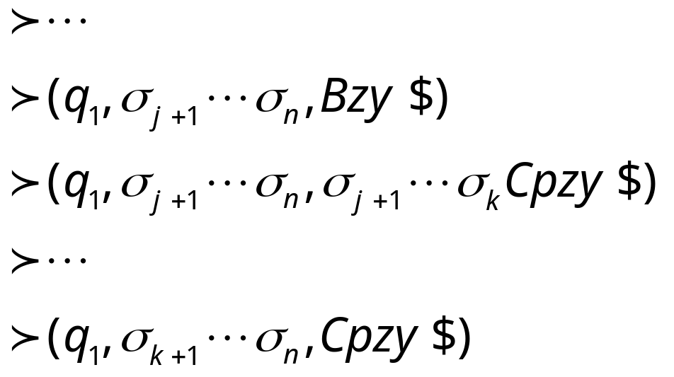
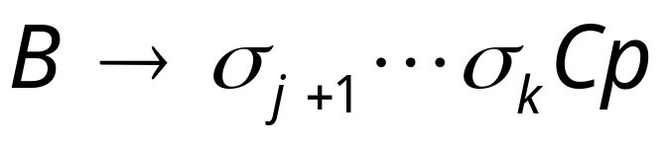
The process repeats with the next
leftmost variable
Production applied
And so on……
KJSCE

Slide 28




Example:
Input
Time 0
Stack
KJSCE

Slide 29


Derivation:
Input
Time 1
Stack
KJSCE

Slide 30


Derivation:
Input
Time 2
Stack
KJSCE

Slide 31
Derivation:
Input
Time 3
Stack
KJSCE

Slide 32

Derivation:
Input
Time 4
Stack
KJSCE

Slide 33
Derivation:
Input
Time 5
Stack
KJSCE

Slide 34
Derivation:
Input
Time 6
Stack
KJSCE

Slide 35
Derivation:
Input
Time 7
Stack
KJSCE

Slide 36
Derivation:
Input
Time 8
Stack
KJSCE

Slide 37
Derivation:
Input
Time 9
Stack
KJSCE

Slide 38
Derivation:
Input
Time 10
Stack
accept
KJSCE

Slide 39
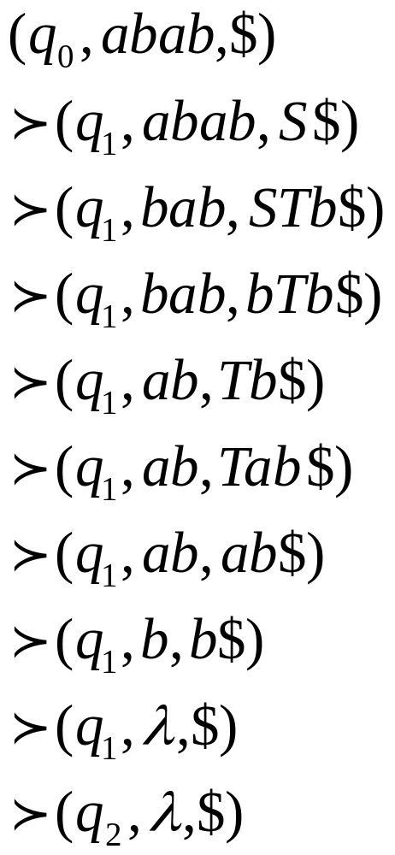
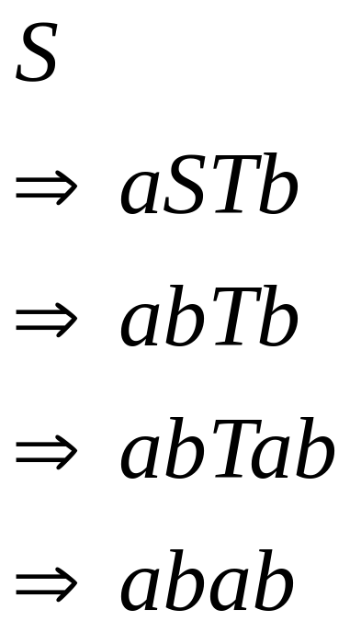
Grammar
Leftmost Derivation
PDA Computation
KJSCE

Slide 40

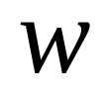
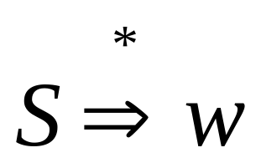
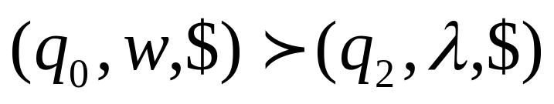
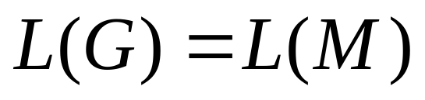
In general, it can be shown that:
Grammar
generates
string
If and
Only if
PDA
accepts
Therefore
KJSCE

